Slide 1

SYSTEM BASIC CONCEPT
MANAGEMENT INFORMATION SYSTEM
DEPARTMENT of Information Technology

Slide 2

System
The word system comes from the Greek, namely systema, which means a set of parts or components that are interconnected regularly and constitute a whole.
The system is a collection of several parts that are related and work together and form a unity to achieve the goals of the system
The system consists of structures and processes.
Notes:
1. Struktur sistem merupakan unsur-unsur yang membentuk sistem tersebut, sedangkan proses sistem menjelaskan cara kerja setiap unsur sistem dalam mencapai tujuan 2. Setiap sistem merupakan bagian dari sistem lain yang lebih besar dan terdiri atas berbagai sistem yang lebih kecil, yang disebut subsistem. Setiap sistem diciptakan untuk menangani sesuatu yang berulang-ulang atau yang secara rutin terjadi 3.

Slide 3
System Concept
The system is a relationship between one unit and another that is interconnected with one another and cannot be separated and leads to a unity in order to achieve predetermined goals. For example, if one unit in a company is disturbed, the other units will also be disturbed in achieving the goals that have been set.
A concrete example of a system, namely human organs and computer electronic components that make up a communication system.

Slide 4
Subsistem
Each system is part of another larger system and consists of various smaller systems, called subsystems.
Subsystem is a component or part of a system, can be physical or abstract.
Example: A car is a system consisting of an engine system, a frame system, and a car body system.

Slide 5
Suprasistem
Supersystem is a system that has a wider relationship than the system. If a system becomes part of another larger system, the larger system is known as a suprasystem.
Example of a supersystem: if schools are seen as a system, education is the supersystem; If the company is seen as a system, industry is the supersystem and marketing is the subsystem.

Slide 6

Systems Development Approach
Prototyping
Joint Application Design (JAD)
Structured Analysis and Structures Design
Object Oriented Analysis and Design (OOAD)
Notes:
1) Prototyping, yaitu proses interaktif dalam pengembangan sistem di mana requirement diubah ke dalam sistem yang bekerja secara terusmenerus diperbaiki melalui kerja sama antara user dan analis. Tujuan prototyping, yaitu untuk bias dibangun beberapa tools pengembangan untuk menyederhanakan proses. 2) Joint Application Design (JAD), yaitu proses terstruktur di mana user, manajer, dan analis bekerja bersama-sama selama beberapa hari dalam satu pertemuan bersama untuk mengumpulkan requirement system yang akan dibangun. 3) Structured analysis and structured design. Pendekatan ini lebih berfokus pada cara mereduksi waktu dan maintenance dalam pengembangan sistem. Pendekatan ini pun langsung mengintegrasikan perubahan jika diperlukan. 4) Object Orientied Analysis and Design (OOAD) merupakan metode pengembangan sistem yang lebih menekankan objek dibandingkan dengan data atau proses.

Slide 7
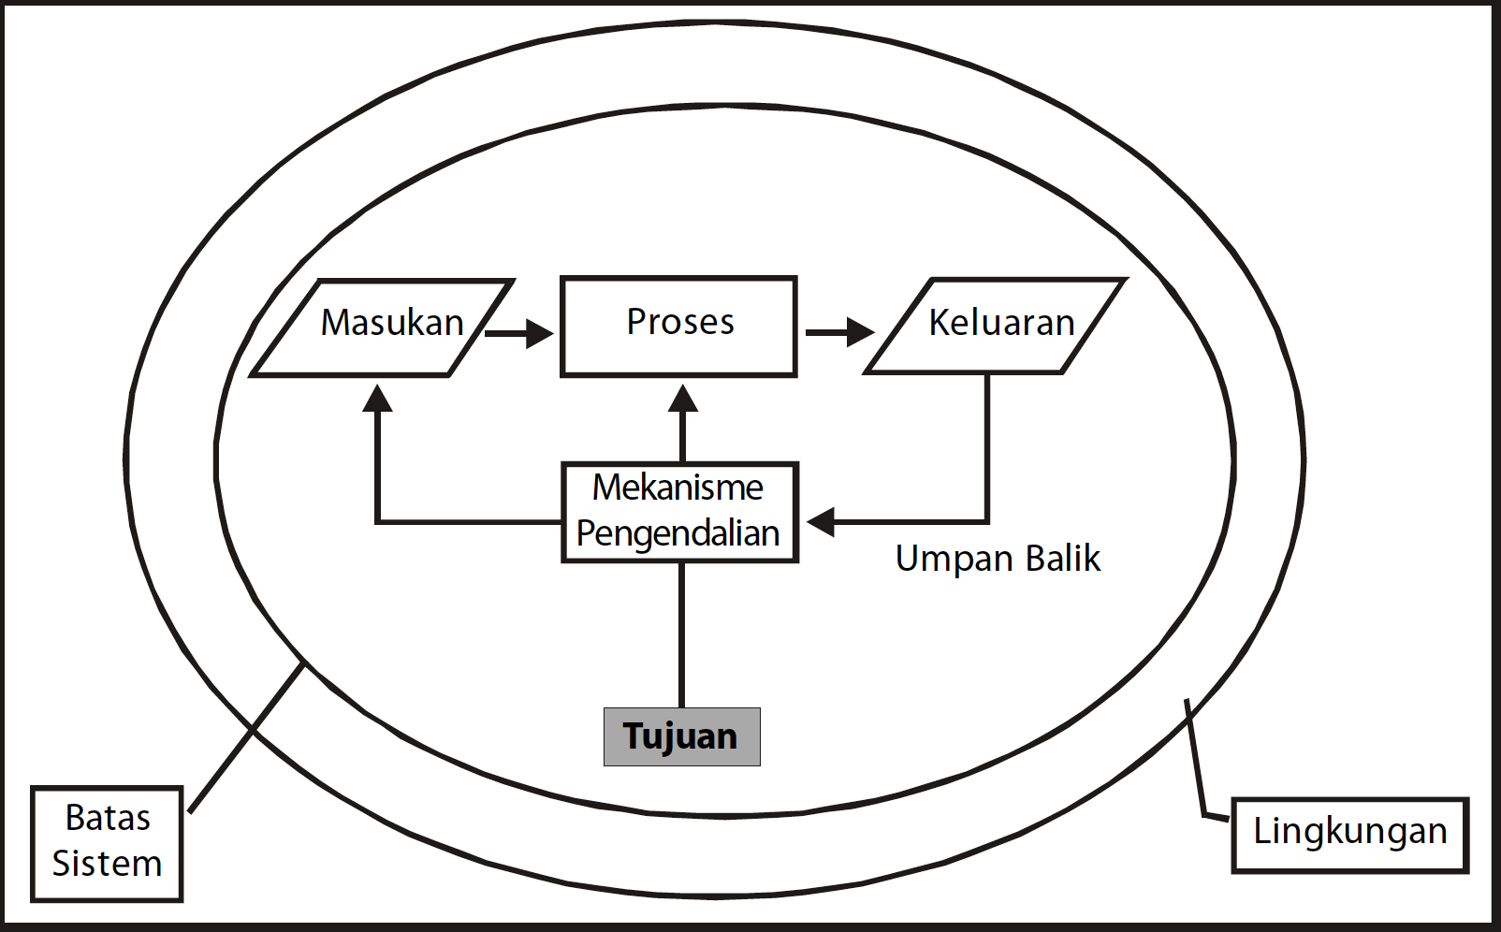
System Characteristics
Component
Limit
Environment
Interface
Input
Processing
Output
Goals and goals
control
Feedback

Slide 8
System Design
According to Burch and Grundnitski (Jogiyanto, 2005: 196), system design can be defined as drawing, planning, and making sketches or arrangements of several separate elements in a unified whole and functioning.
System design can be interpreted:
The post-analysis stage of the system development cycle
Definition of functional requirements
Preparation of design for implementation
Describe how a system is formed

Slide 9
System Life Cycle
The system life cycle is an evolutionary process followed in implementing a computer-based information system or subsystem. The system life cycle consists of a series of tasks that closely follow the steps of the systems approach because these tasks follow a regular pattern and are performed on a top-down basis.
System Lifecycle Phase
Recognizing a need
System development
System installation
System operation
The system becomes obsolete

Slide 10

System Form
Systems based on basic principles are generally divided into:
Specialized system
i.e. systems that are difficult to apply to different environments (e.g. biological systems; fish moved ashore)
Big system
i.e. systems where most of the resources are used to carry out daily maintenance (eg dinosaurs as a biological system spent most of their lives eating);
System as part of another system
a system that is part of a larger system and can be divided into smaller systems
The system develops even though it does not apply to all systems, but almost all systems are always evolving
Notes:
sistem terspesialisasi, yaitu sistem yang sulit diterapkan pada lingkungan yang berbeda (misalnya sistem biologi; ikan yang dipindahkan ke darat); b. sistem besar, yaitu sistem yang sebagian besar sumber dayanya berfungsi melakukan perawatan harian (misalnya dinosaurus sebagai sistem biologi menghabiskan sebagian besar masa hidupnya dengan makan); c. sistem sebagai bagian sistem lain, yaitu sistem yang merupakan bagian dari sistem yang lebih besar dan dapat terbagi menjadi sistem yang lebih kecil; d. sistem berkembang walaupun tidak berlaku bagi semua sistem;tetapi hampir semua sistem selalu berkembang.

Slide 11

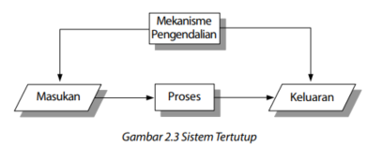
Jenis Sistem
The type of system in general consists of an open system and a closed system.
An open system is one that lacks goals, mechanical controls, and feedback.
The closed system is a system that has targets, mechanical control, and feedback.

Slide 12
System Classification
Systems can be classified from several points of view, including the following:
Systems are classified as abstract systems and physical systems.
Systems are classified as natural systems and man-made systems.
Systems are classified as specific systems and indeterminate systems.
Systems are classified as closed and open systems.

Slide 13
System Actors
User
In general, there are three types of users, namely operational, supervisory, and executive.
Management
User management is in charge of handling usage when a new system is implemented
system management applied in system development
general management involved in strategic planning systems and decision support systems
Examiner
Systems Analyst: Archaeologist, Innovator, Mediator, Leader
System designer
Programmer
Operations personnel

Slide 14
System Model
The model can be used in the analysis process to develop an understanding of the system. This understanding can be seen from different points of view, namely external point of view (where the context or system environment is modeled), behavioral (where system behavior is modeled), and structural (where data structures are modeled).

Slide 15
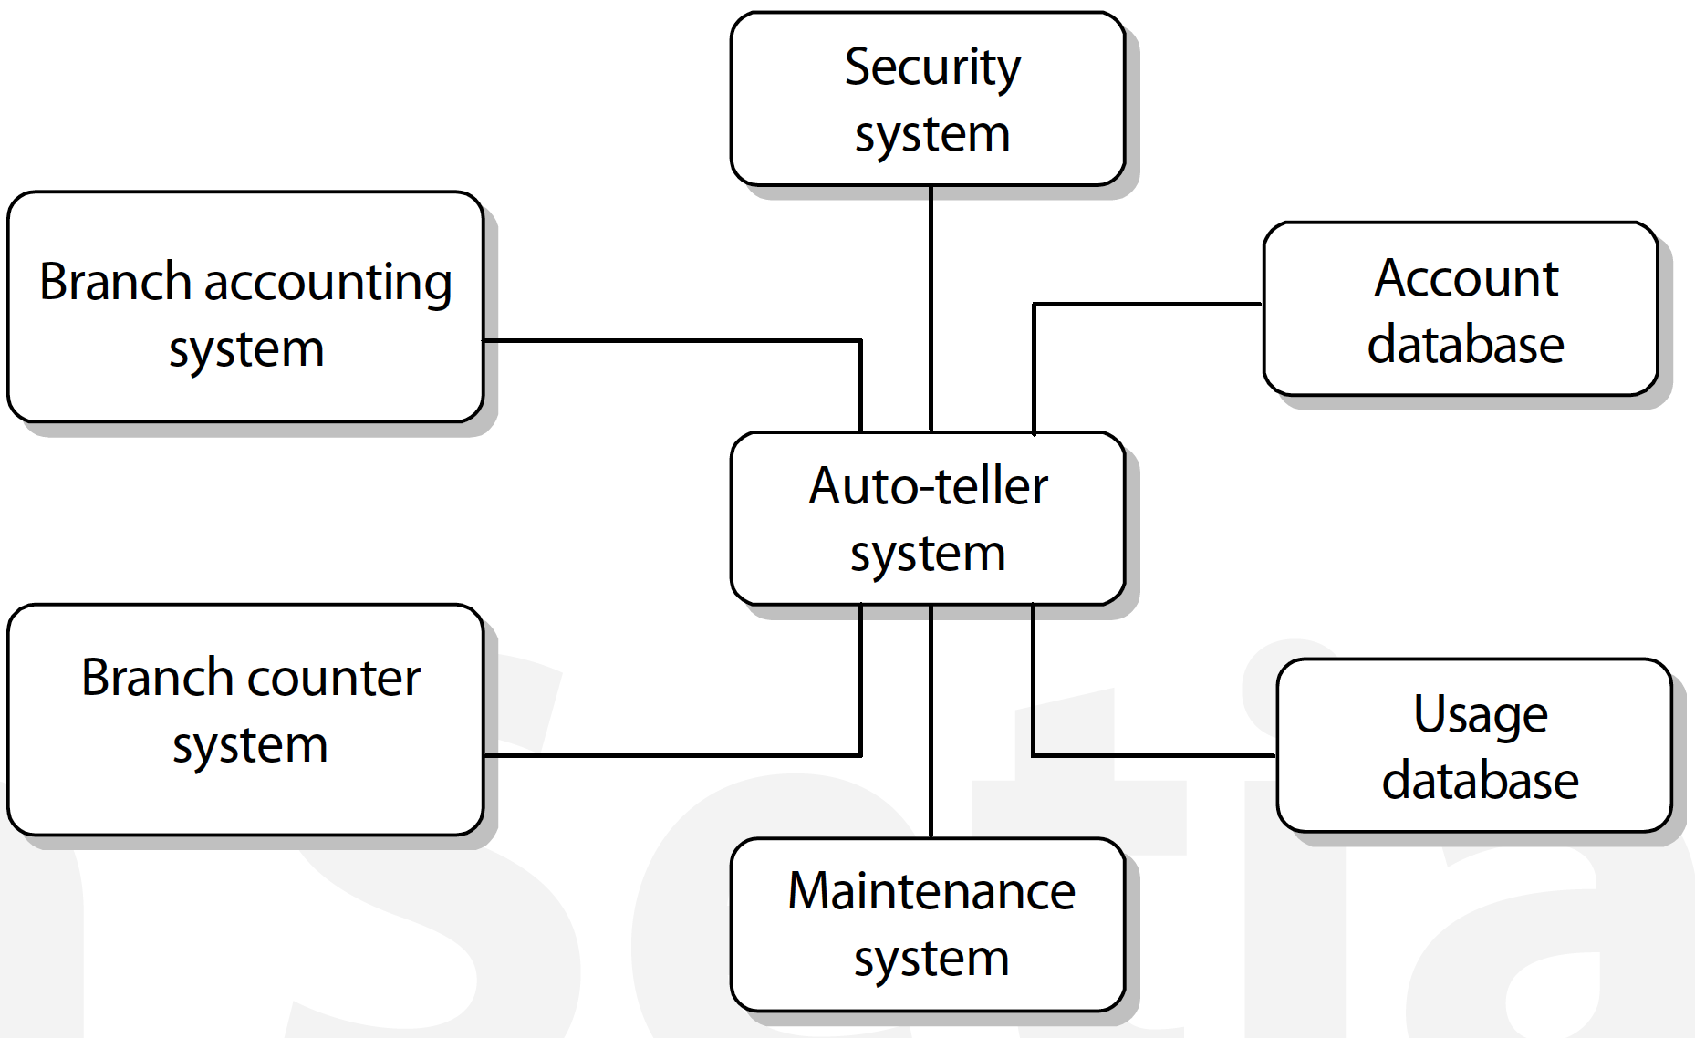
System Model (2)
Context model
At an early stage, the requirements elicitation and analysis process should be decided on the system boundaries. This includes working with system stakeholders to differentiate between the system and the environment.
In addition, it is also necessary to limit costs and time. Once the system boundaries are defined, part of the analysis activity is the definition of the context and its dependence on its environment. This is illustrated in the following figure the information structure covering the auto-teller network at the bank.

Slide 16
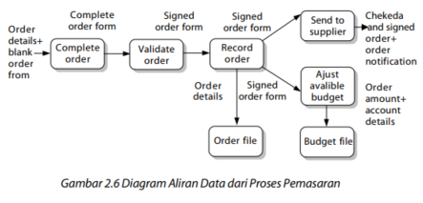
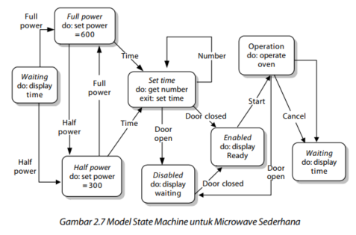
System Model (3)
2. Behavioral Model
This model is used to describe the overall behavior of the system. There are 2 types of behavior models: data flow models and state machine models.
Data flow models are an intuitive way to show how data is processed by the system. The notation used in this model represents functional processing. This model is used to show how data flows through a series of processing steps. The processing steps are a function of the software program. The development of the data flow model must use the top down principle.
State machine models are used to model system behavior in response to internal or external events. This model shows the state of the system and the events that cause the transition from one state to another. This model does not show the flow of data in the system. This model is useful for real time processing because the system is often controlled by stimuli from the system environment.

Slide 17
System Model (3)
3. Object Model
An object-oriented approach to all software development is now commonly used, especially for the development of interactive systems. This means that system requirements are carried out using object models, system design is carried out using objects, and system development is carried out in object-oriented programming languages.
Booch, Rambaugh, and Jacobson integrated their approaches to produce a unified method. The Unifield Modeling Language (UML) used in this unified method becomes an effective standard for object modeling. UML includes notations for various types of system models.

Slide 18
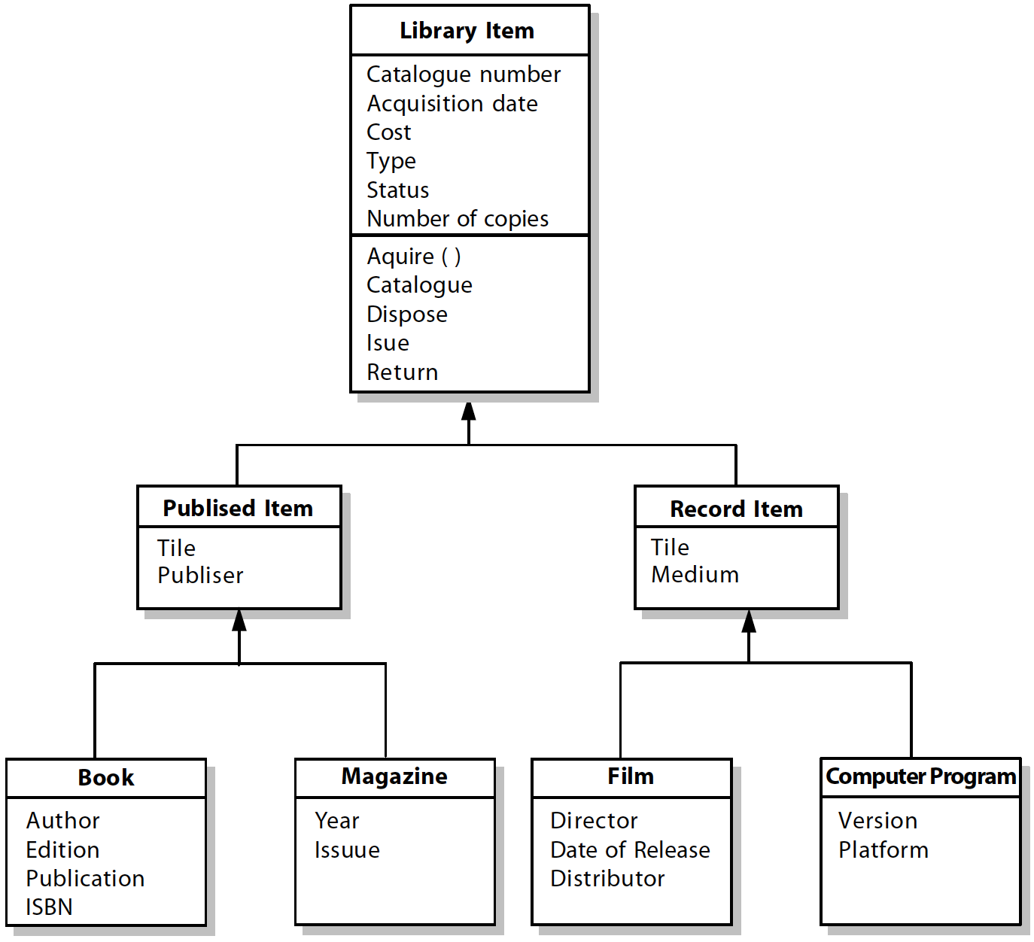
System Model (4)
Class Hierarchy for Library System:

Slide 19
Let’s Discuss

